Slide 1
Event
Presenter
Instance
of the story
Audience

Slide 2
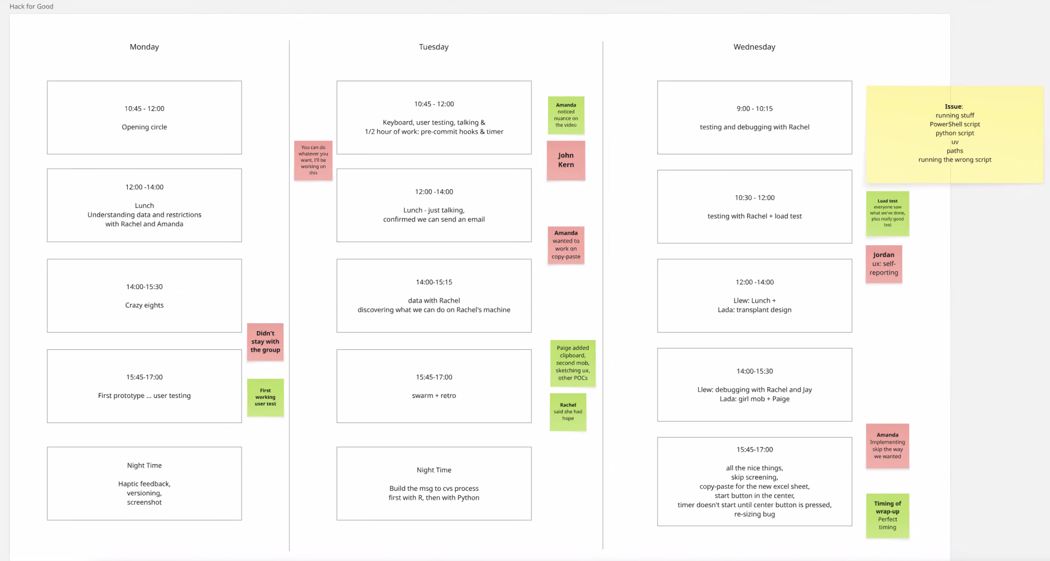

Slide 3
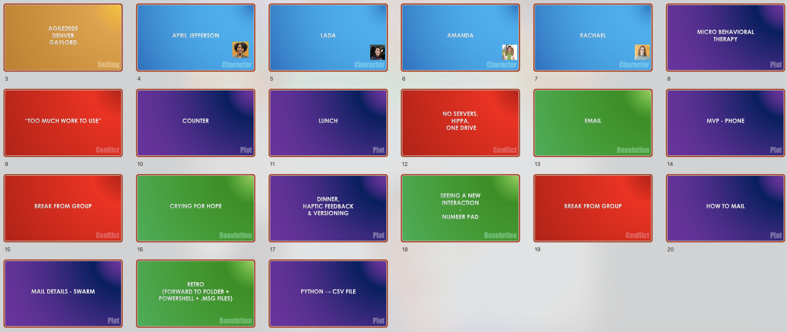

Slide 4
Agile2025 Denver Gaylord

Slide 5
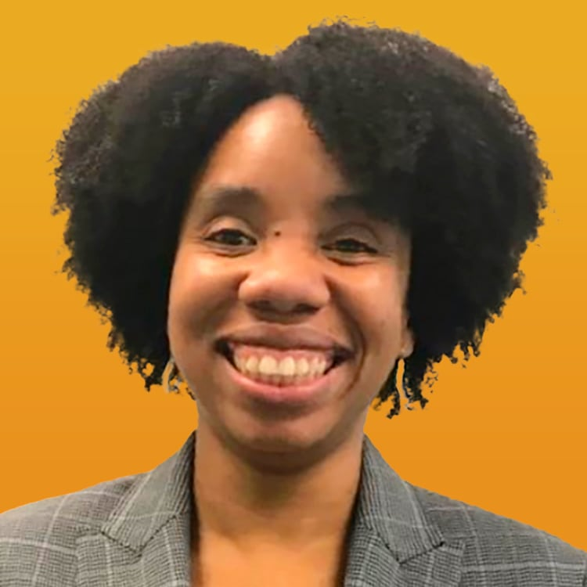
April Jefferson

Slide 6
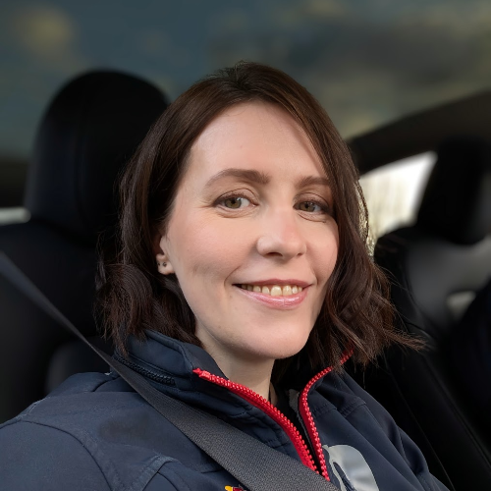
LADA

Slide 7
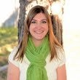
AMANDA
Notes:
Psychologist – Trainer

Slide 8
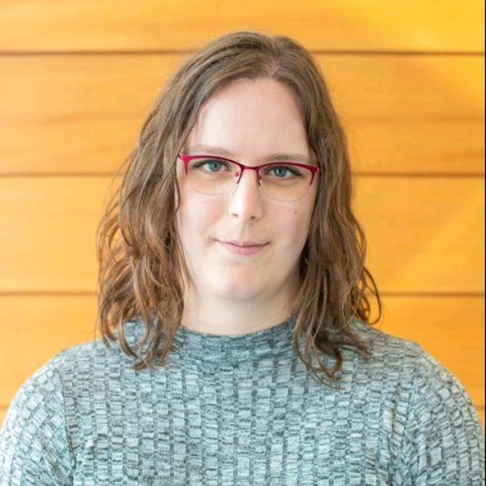
Rachael
Notes:
Data Scientist at Kempe Center

Slide 9
Micro Behavioral Therapy

Slide 10
“Too MUCH WORK TO USE”

Slide 11
Counter

Slide 12
LUNCH with Amanda & Rachel

Slide 13
NO SERVERs, HIPPA, One DRIVE

Slide 14
EMAIL

Slide 15
MVP - PHONE

Slide 16
Break from Group

Slide 17
CRYING FOR HOPE

Slide 18
DINNER, Haptic feedback & Versioning

Slide 19
SEEING A NEW INTERACTION - NUMBER PAD
Notes:
Counting the rocks -> the kid start counting

Slide 20
Break from Group

Slide 21
How to MAIL

Slide 22
MAIL DETAILS - SWARM

Slide 23
RETRO (forward to Folder + Powershell + .msg files)
Notes:
Counting the rocks -> the kid start counting

Slide 24
PYtHON → CSV file

